Slide 1
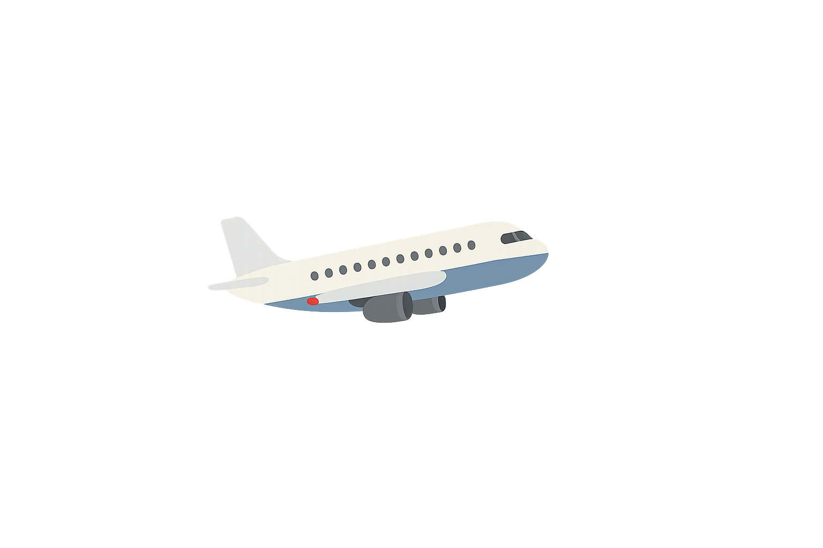
Wanderlust Categorized:
Data-Driven Customer Segmentation for TravelTide
Blending business rules with machine learning to drive smarter rewards and personalization.
By Dido De Boodt
Notes:
Welcome everyone. Today, I'm excited to share the results of the customer segmentation project for TravelTide.

Slide 2
Project Overview
Goal
Why it matters
Approaches
Segment TravelTide customers to design a targeted rewards program and enhance marketing strategies.
Personalization boosts customer satisfaction, loyalty, and conversion rates.
Rule-Based Segmentation (based on known behavior patterns)
ML-Based Segmentation (unsupervised clustering to uncover hidden groups)
Notes:
This initiative focused on understanding the diverse customer base to create more targeted rewards programs and enhance marketing strategies.
In the next few minutes, I'll walk you through our approach, the key customer segments that were identified, and the actionable insights that will help drive personalization across the platform.

Slide 3
Project Steps
Exploratory Data Analysis
Cleaned data and filtered 50,000 sessions for exploration to understand the users and explore patterns.
Rule-Based Groups
Created rule based segments based on insights derived from exploratory data analysis.
Machine Learning Algorithms
Applied PCA for dimensionality reduction and used K-Means and DBSCAN to create clusters in the data.
Data
Cohort Selection
Selected a cohort to use for ML clustering algorithms, by querying an user-based table with SQL.
Sessions older than 2023-01-05 Users with more than 7 sessions
Feature Engineering and Preprocessing
Created new features and prepared the data for ML clustering algorithms.
User Groups and Perks
Created personas for each group with perks.
Cohort Selection
Notes:
The project followed a systematic approach consisting of six key steps:
First, with Exploratory Data Analysis, over 50,000 user sessions were filtered and cleaned to understand behavioral patterns. This gave us our first glimpse into who our users are and how they interact with our platform.
For Cohort Selection, we focused on users with more than 7 sessions from January 2023 onward, ensuring we based our analysis on engaged customers with sufficient data points.
We then applied two segmentation approaches:
A Rule-Based Approach that created segments based on demographic and behavioral insights from the initial analysis.
Machine Learning Algorithms: Using unsupervised clustering techniques to uncover hidden patterns. Here we performed Feature Engineering to prepare our data, followed by applying PCA for dimensionality reduction and clustering algorithms, including K-Means and DBSCAN.
Finally, we created detailed User Groups and Personas with tailored perks to enhance their travel experience.

Slide 4
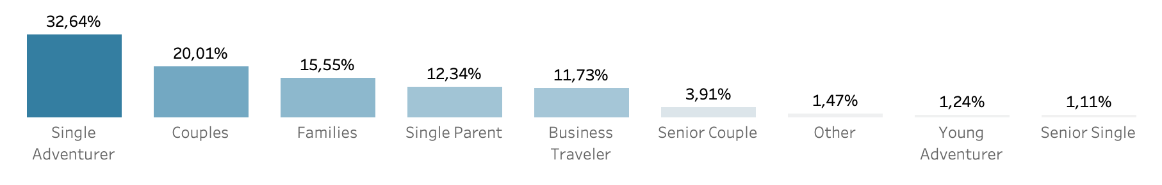
Rule Based Segmentation
1
Single Adventurer
18+
Not married and no children
Open to explore and meet new people
5
Business Traveler
More than 4 trips
Less than 2 bags and 2 rooms
Prioritizes efficiency, flexibility, and convenience
2
Couples
30 - 59
Married and no children
Often travel for romantic getaways or city breaks
6
Senior Couple
60+
Married
Values comfort, safety, and relaxing experiences
3
Families
30+
Married with children
Need convenience, affordability, and child-friendliness.
7
Young Adventurer
Younger than 18
No children and not married
Seeking experiences, often budget-focused
4
Single Parent
19+
Not married with children
Budget-aware, time-stressed, needs practical perks
8
Senior Single
60+
Not married
May be solo-traveling for leisure or to visit family
Notes:
The rule-based approach identified eight distinct traveler segments based on known behavioral patterns and demographics.
The largest segment is "Single Adventurer" with nearly 33% of the users. They are individuals over 18 who travel solo and are open to new experiences.
This is followed by "Couples" with 20% of the users, primarily ages between 30 and 59, who travel for romantic getaways.
"Families" are about 16% of the users and are typically 30+ years old, married with children, and prioritize convenience and affordability.
Other segments include "Single Parent", "Business Traveler", "Senior Couple", "Young Adventurer", and "Senior Single" each with distinct characteristics and needs.
This distribution gives us a clear picture of who the primary customers are and helps us prioritize our marketing efforts.

Slide 5



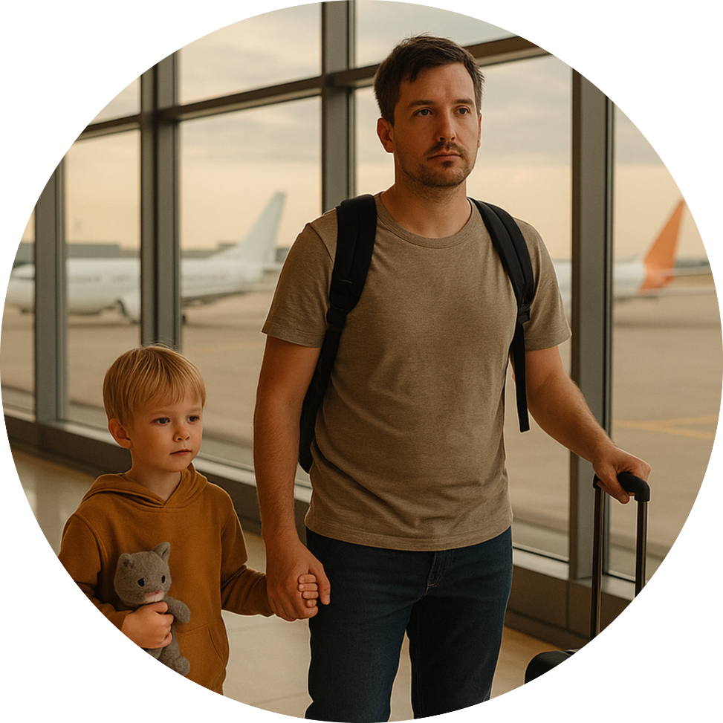
Lovebirds on Leave
Couples
“Just the two of us,
and a hot tub please!”
The Nesters
Families
“Family is all you need for the best holiday memories!”
✅Offer a romantic package (wine, flowers, spa) or weekend deals
✅ Offer free stay for children or a child friendly entertainment package (partner deals)
Golden Getaway
Senior Couple
“Retired from work,
not from wonder!”
Power Parent
Single Parent
“One parent, many hats, no time to waste!”
✅Offer a room upgrade to a quiet floor, or with a scenic view
✅Offer flexible booking policies or hotel babysitting
Notes:
Based on the rule-based segments, we've developed relatable personas that bring the customers to life.
"Lovebirds on Leave" represent the Couples segment. They're looking for romantic experiences and appreciate packages that include amenities like wine, flowers, or spa treatments.
"The Nesters" embodies the Family segment, they value free stay for children and entertainment packages that create memorable family experiences.
"Golden Getaway" represent the Senior Couples – retired travelers who appreciate comfort, safety, and room upgrades to quiet floors with scenic views.
"Power Parent" captures the single-parent segment – time-stressed individuals who benefit greatly from flexible booking policies and hotel babysitting services.

Slide 6




Freewheel Solo
Single Traveler (>18)
“One backpack. No plan. All in.”
Trailblazer in Training
Young Traveler (<18)
“Too young to rent a car, but not too young to explore the world.”
✅Offer public transport pass or discounted solo tours
✅ Offer discounted adventure or social group tours
Jet-Set Pro
Business Traveler
“In by 9, out by 5 — and onto the next city.”
Silver Explorer
Single Senior (>60)
“One ticket, one heart, endless stories.”
✅Offer flight upgrades or access to airport lounge
✅ Offer curated tours or emergency contact services
Notes:
Continuing with our personas:
"Freewheel Solo" represents the Single Adventurer segment – independent travelers who appreciate public transport passes and discounted solo tours.
"Trailblazer in Training" embodies the Young Travelers – under 18, budget-conscious, and drawn to discounted adventure or social group tours.
"Jet-Set Pro" represents the Business Travelers – efficiency-focused individuals who value flight upgrades and airport lounge access.
"Silver Explorer" captures the Single Seniors – travelers over 60 who appreciate curated tours and emergency contact services for peace of mind.

Slide 7
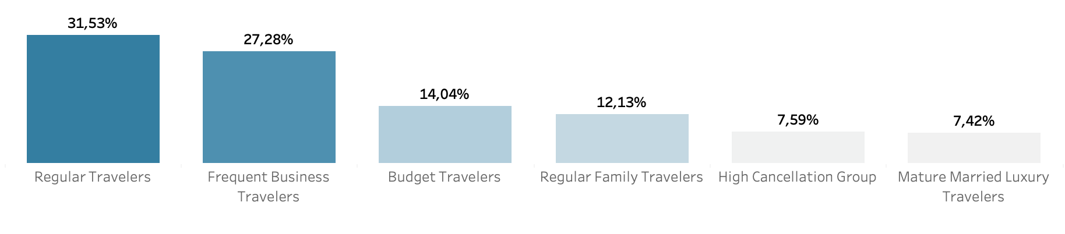
K-Means Segmentation
1
Regular Travelers
Average age is 42
Not married without children
Regular, consistent travel patterns
4
Regular Family Travelers
Average age is 47
Married with children
Moderate travel behavior
Highest average of checked bags
2
Frequent Business Travelers
Average age is 44
Highest trips, flights, and spending
Frequent flyers, value efficiency
5
High Cancellation Group
Average age is 43
Not married without children
Extremely high cancellation rate
Low follow-through on bookings
3
Budget Travelers
Average age is 32
Not married without children
Fewest trips and lowest spending
6
Mature Married Luxury Travelers
Average age is 57
Married without children
Fewer trips, longer stays, high average spending,
Notes:
Moving to our machine learning approach, K-Means clustering revealed six distinct segments based purely on behavioral data.
The two largest segments are "Regular Travelers" at 32% and "Frequent Business Travelers" at 27% of users.
"Budget Travelers" make up 14% of users and are typically younger with an average age of 32 and the fewest trips with the lowest spending.
"Regular Family Travelers" represent 12% of users with moderate travel behavior, but have the highest average of checked bags.
The "High Cancellation Group" and "Mature Married Luxury Travelers" are smaller segments but offer valuable insights into behaviors we need to address or can leverage for premium offerings.

Slide 8

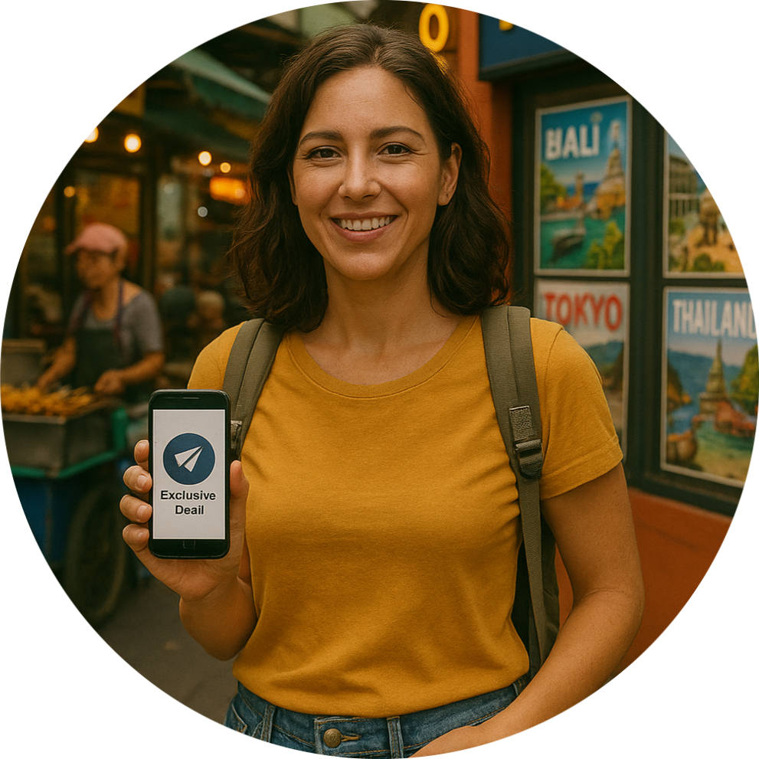
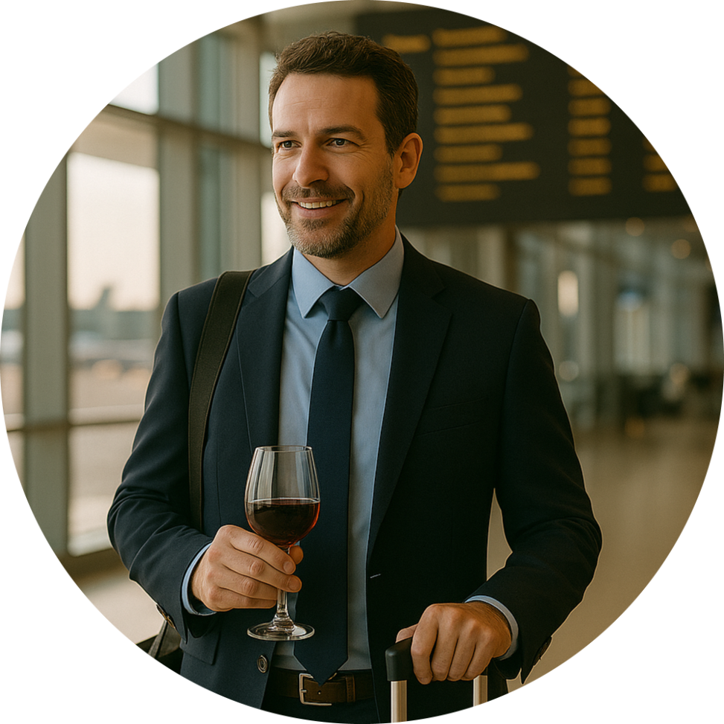
The Steady Explorers
Regular Traveler
“I love planning spontaneous getaways — not too fancy, just new experiences and a change of scenery.”
✅ Offer targeted destination packages
The Spontaneous Savers
Budget Traveler
“I travel when the deals are good and the vibe feels right — I’m always up for an adventure, as long as it’s cheap!”
✅ Offer exclusive discounts or Last-minute deal alerts
The Executive Jetsetters
Business Travelers
“Efficiency, comfort, and staying connected — travel is part of the job, but I expect it to run smoothly.”
✅ Offer airport lounge access or Express check-in/security lane access
Notes:
Based on our machine learning segments, we've developed data-driven personas:
"The Steady Explorers" represent the Regular Travelers – they enjoy planning spontaneous but not extravagant trips and respond well to targeted destination packages.
"The Spontaneous Savers" captures the Budget Travelers – deal-seekers who respond to exclusive discounts and last-minute offers.
"The Executive Jetsetters" embodies the Business Travelers – efficiency-minded professionals who value comfort perks like lounge access and expedited check-in.

Slide 9



The Family Explorers
Regular Family
Travelers
“Traveling with the kids isn’t just a holiday — it’s how we make memories that last a lifetime.”
✅ Offer free checked bags (they have highest average checked bags)
The Golden Indulgers
Mature Married Luxury Travelers
“We prefer fewer trips, but each one is special — comfort, fine dining, and time to unwind together.”
✅ Offer a free hotel night on longer stays (they already stay longest)
The Uncommitted Clickers
High Cancellation Group
“Life changes fast — I book when I can, but I need the flexibility to change my plans without stress.”
✅ Offer free cancellation
Notes:
"The Family Explorers" represent the Regular Family Travelers – they value creating lifelong memories and appreciate free checked bag allowances since they typically travel with more luggage.
"The Golden Indulgers" captures the Mature Married Luxury Travelers – they take fewer trips but stay longer and spend more, making them ideal candidates for free hotel night offers on extended stays.
"The Uncommitted Clickers" represent the High Cancellation Group – they need flexibility and respond best to free cancellation policies.

Slide 10
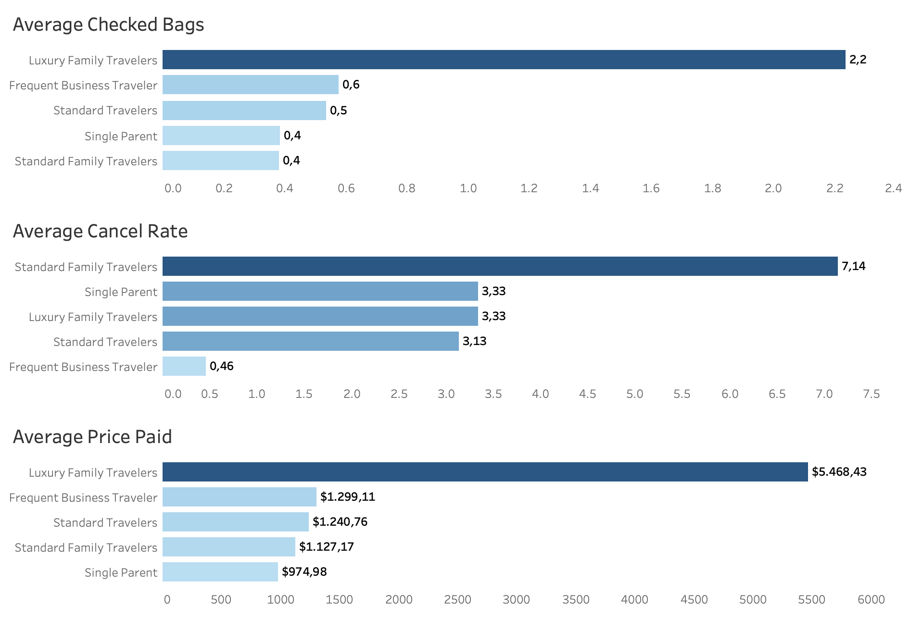
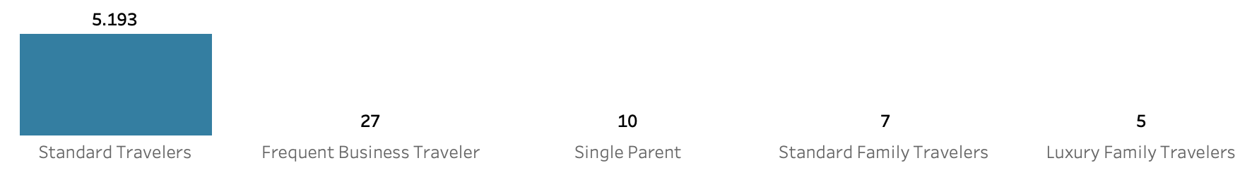
DBSCAN Segmentation
1
Standard Travelers
Average age is 43
Not married without children
Average trips, flights, spending, and stay
2
Frequent Business Travelers
Average age is 45
Highest trips, flights, and spending
Frequent flyers, low cancellation
3
Single Parents
Average age is 40
Not married with children
Moderate trips and flights with low spending
4
Standard Family Travelers
Average age is 45
Married with children
Family travelers with high tendency to cancel
5
Luxury Family Travelers
Average age is 37
Married with children
Highest spending with the most average checked bags
Notes:
Our DBSCAN analysis provided deeper insights by identifying five key segments while filtering out noise:
"Standard Travelers" form the largest group with average metrics across the board.
"Frequent Business Travelers" show high trip frequency and spending with remarkably low cancellation rates.
"Single Parents" demonstrate moderate trips with lower spending, suggesting price sensitivity.
"Standard Family Travelers" have the highest cancellation rates – an insight that warrants further investigation.
"Luxury Family Travelers" stand out with the highest spending ($5,468 average) and most checked bags, representing our premium family segment.
These insights allow to target pain points like high cancellation rates and capitalize on opportunities with our high-value segments.

Slide 11
Conclusion and Recommendation
Conclusion
📌 Rule-based groups helped frame customer types
📌 K-means provides superior business value
📌 DBSCAN's strong mathematical clustering doesn't translate to actionable insights
Recommendations
✅ Launch Personalized Perks Program based on the 6 K-means segments
✅ Prioritize High-Value Segments and develop Cancellation strategies
✅ Create VIP Treatment for the 5 luxury outliers identified by DBSCAN
✅ Conduct Retention Interventions for at-risk customers in smaller DBSCAN clusters
✅ Re-evaluate segment and perk performance quarterly
Notes:
Before we close, a quick disclaimer: This is an initial segmentation based on available data. Before full rollout, further validation is essential. Segment performance should be monitored regularly and refreshed with updated data.
To recap:
The rule-based approach gave us a useful starting point to define broad customer types.
K-Means segmentation uncovered deeper behavioral patterns—forming 6 distinct and actionable customer groups, large enough to target with tailored perks.
DBSCAN highlighted micro-clusters—including luxury outliers and at-risk customers—which, while not scalable for perks, offer important strategic touchpoints.
So what’s next?
We recommend launching a Personalized Perks Program based on the K-Means segments, with a focus on Frequent Business Travelers, our most profitable group. At the same time, implement cancellation strategies for segments with high churn risk.
For the few VIP customers and smaller DBSCAN clusters, we propose retention strategies—these could become our most loyal or highest-value users over time.
Finally, reassess and refine quarterly to keep pace with customer behavior.
This segmentation gives the roadmap to not just understand the users—but to engage them in a smarter, more human way.

Slide 12
Thank you for your attention!
Notes:
Thank you for your time—Feel free to reach out if you have any questions.

